Slide 1
Internet of Things Lab Special Lab
World IoT Day-2022

Slide 2
MILK MONITORING UNIT
IDEA PRESENTATION

Slide 3
ABSTRACT
The process of collecting, measuring the number of liters of milk being milked from the cow becomes a tedious process. In this paper, a IoT based milk monitoring system is proposed. Each of the cow is attached with NFC chip. The milk monitoring system consist of NFC reader, milk can with flow sensor, microcontroller, wifi module and mobile application. The NFC reader is used to get the details of the cow from which milk is milked. The flow sensor to measure the number of litters being milked from the cow. The microcontroller to get data from the sensor and store, calculate and to transmit data to the wifi module. The wifi module transmit the data to the mobile app. The mobile app displays the details of milk being milked from the cow and the progress over the week that can be useful to the farmers.

Slide 4
INTRODUCTION
Due to advancements in technology most of formers using milk collector instead of manual collection of milk. That milk collector in normal shops will simply collect the milk if we connect it in the cow.
If we add flow sensor in that milk collector we can easily identify the quantity of milk being milked.

Slide 5
LITERATURE REVIEW
Sl. No. | Author, Paper title and year | Methodology | Remarks
1. | P. R Kadam et al. Real Time Milk Monitoring System 2018. | Spoilage detection in milk. | That equipment will be more sensitive and costly.
2. | Dr. Vishvanath Karad MIT World Peace University,Pune,India.An Internet of Things (IOT) based Monitoring System for Efficient Milk Distribution. | Detection of pH in milk. | Quality of milk cannot be determined with only pH as a factor.
3. | Abirami.V, Anusuya.V, Deepika.S, Divya sri.S,Jayamathi.A Department of ECE, K.S.R College of Engineering, Tiruchengode,Smart Dairy Monitoring System Using Iot. | Spoilage detection in milk. | That equipment will be more sensitive and costly.

Slide 6
PROPOSED METHOD
By fixing an NFC chip in each cow and then we can create individual id for each cow in milk monitoring unit. The milk monitoring unit is fixed in between milk collector which was directly connected to the cow and milk tank.
Before start collecting milk from the cow we have to scan that NFC chip of that cow. Then that monitoring unit start measuring the quality of milk passing through that tube and that reading will be updated in pendrive. By analysing that reading we can identify that which cow producing more milk and which cow was lagging in milk production.

Slide 7
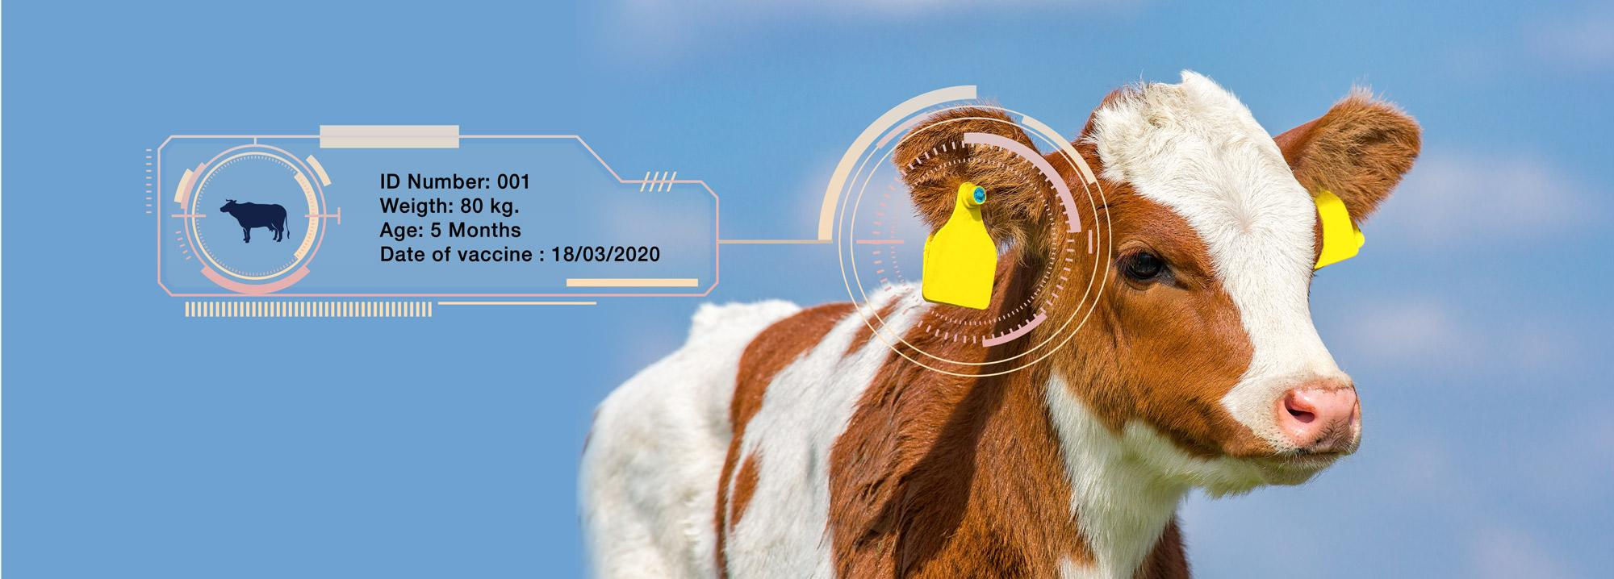

Slide 8
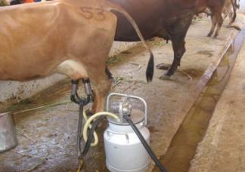

Slide 9
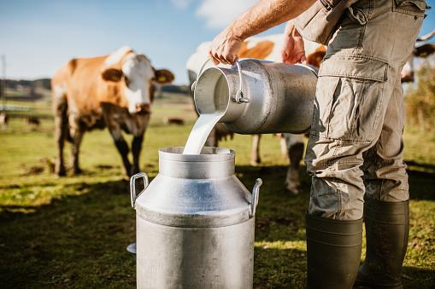

Slide 10
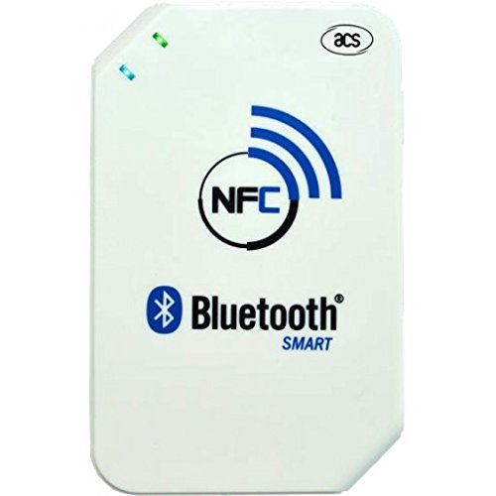

Slide 11
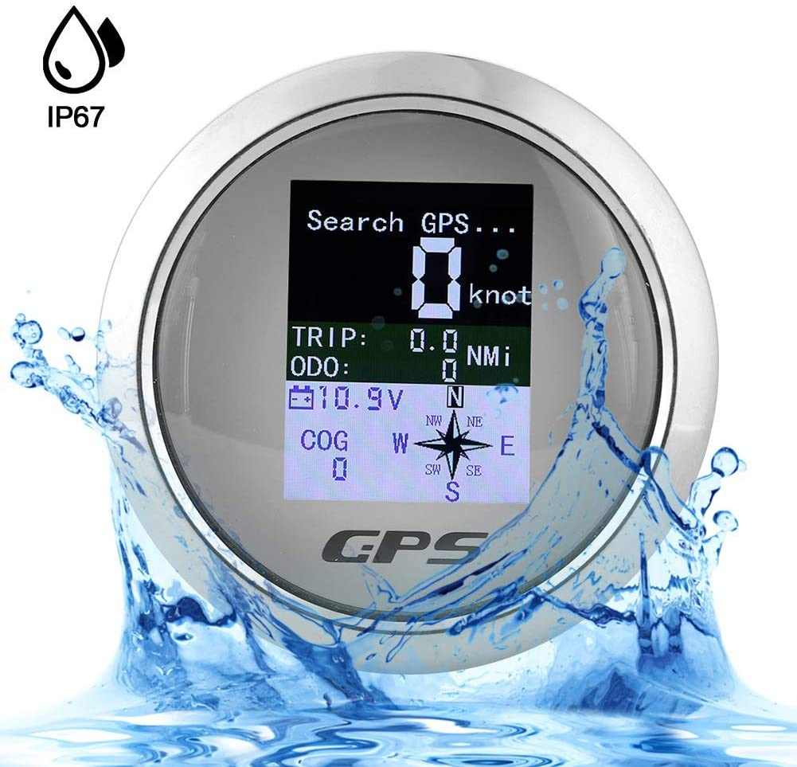

Slide 12
BLOCK DESCRIPTION
Power supply
NFC reader
Wifi
MICRO CONTROLLER
Flow sensor
Display
Mobile
application

Slide 13
ADVANTAGES
Most of the starting stage of disease in cow is decrease in milk production. By analysing the reading we can consult the doctor and cure the disease in starting stage it self and stop spreading to other cows.
Once former identify the low milking cow he can take necessary step to increase its capacity.

